Slide 1
Job Portal Market Insights
The goal of this data analysis project is to uncover key trends and insights from job market data, focusing on company distributions, candidate statuses, and job openings. By analyzing factors like company founding years, job roles, and hiring patterns, the project aims to provide valuable insights for job seekers, recruiters, and industry stakeholders to optimize hiring strategies and understand market trends.

Slide 2
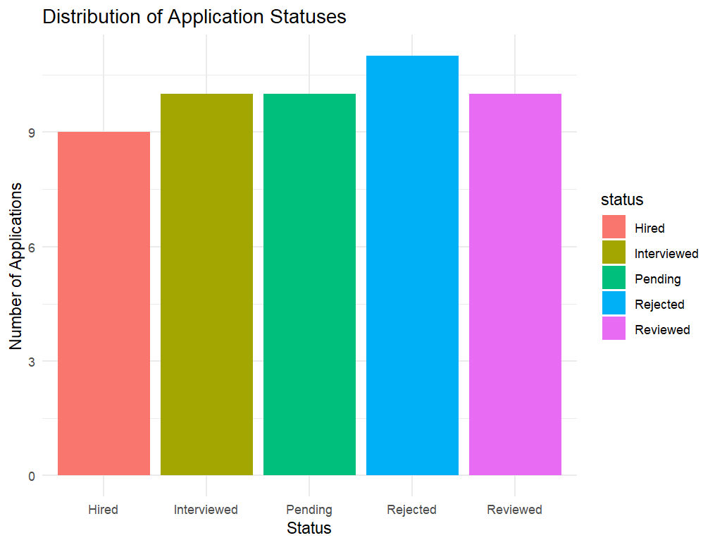
What is the distribution of application statuses?

Slide 3
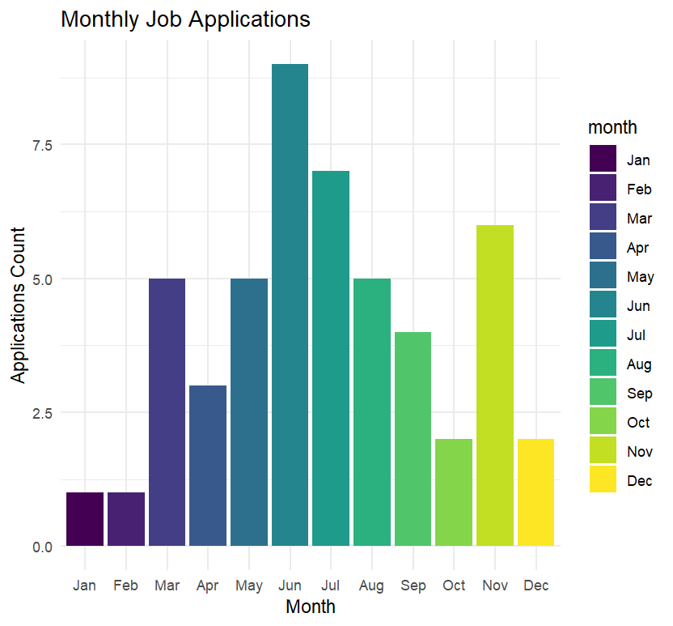
Which month saw the highest number of job applications?

Slide 4
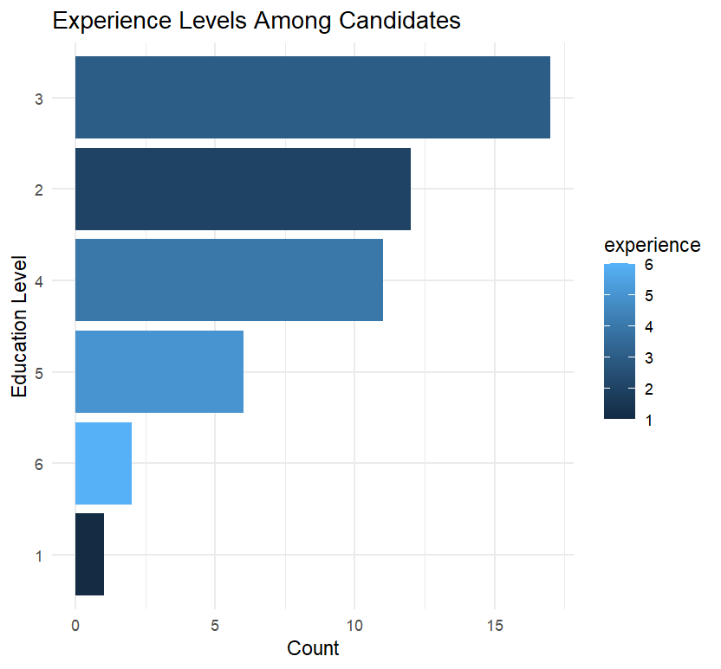
Which Experience levels are most common among candidates?

Slide 5
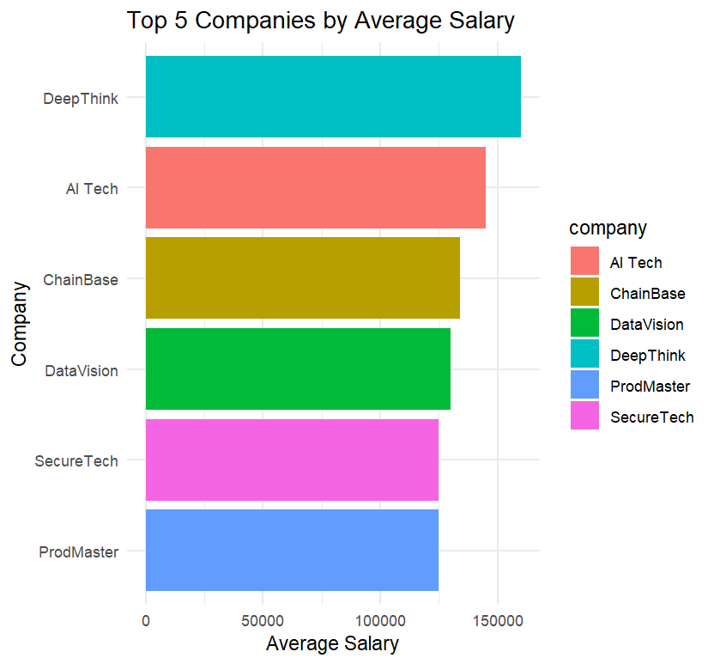
What are the Top 5 Companies by Average Salary?

Slide 6
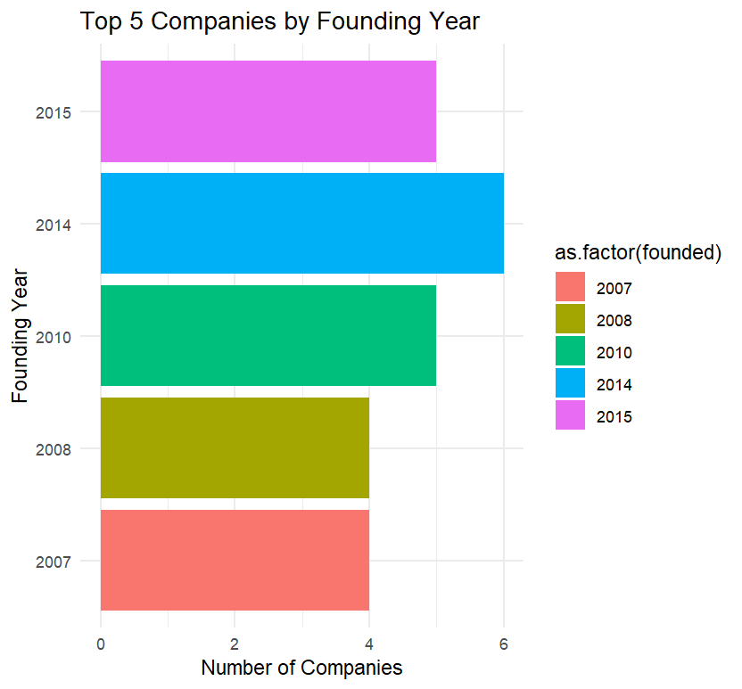
What are the Top 5 Companies by their Founding Year ?

Slide 7
Business Insights
👉 Insight: Recruiters may need to speed up response times and follow-up processes. Job seekers should be aware that patience is often required.
👉 Insight: This could be due to graduation season or seasonal hiring. Job seekers can take advantage of increased opportunities then.
👉 Insight: Companies looking for experienced professionals may face more difficulty. There’s a large supply of fresh or moderately experienced talent.
👉 Insight: These companies may attract top talent more easily. Other firms may need to offer better perks or work culture to compete.
👉 Insight: Startups or newer companies are actively competing for talent, not just established firms.

